Slide 1
Mitosis Lesson

Slide 2
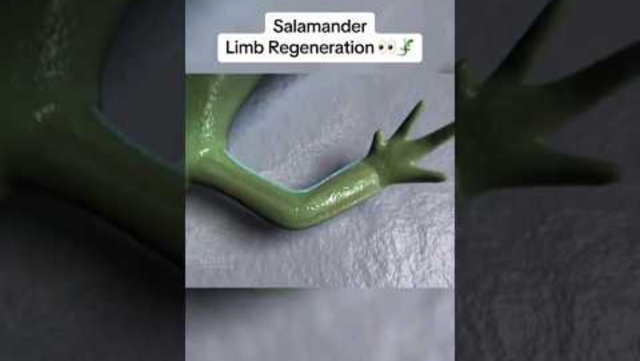

Slide 3
What Did You Notice?
Turn and talk to the person sitting next to you about why you think it is possible for the salamander to regrow its limb.

Slide 4
Class Discussion
How is the salamander able to regrow its limb after losing it?
Why can't humans regrow their limbs like salamanders can?

Slide 5
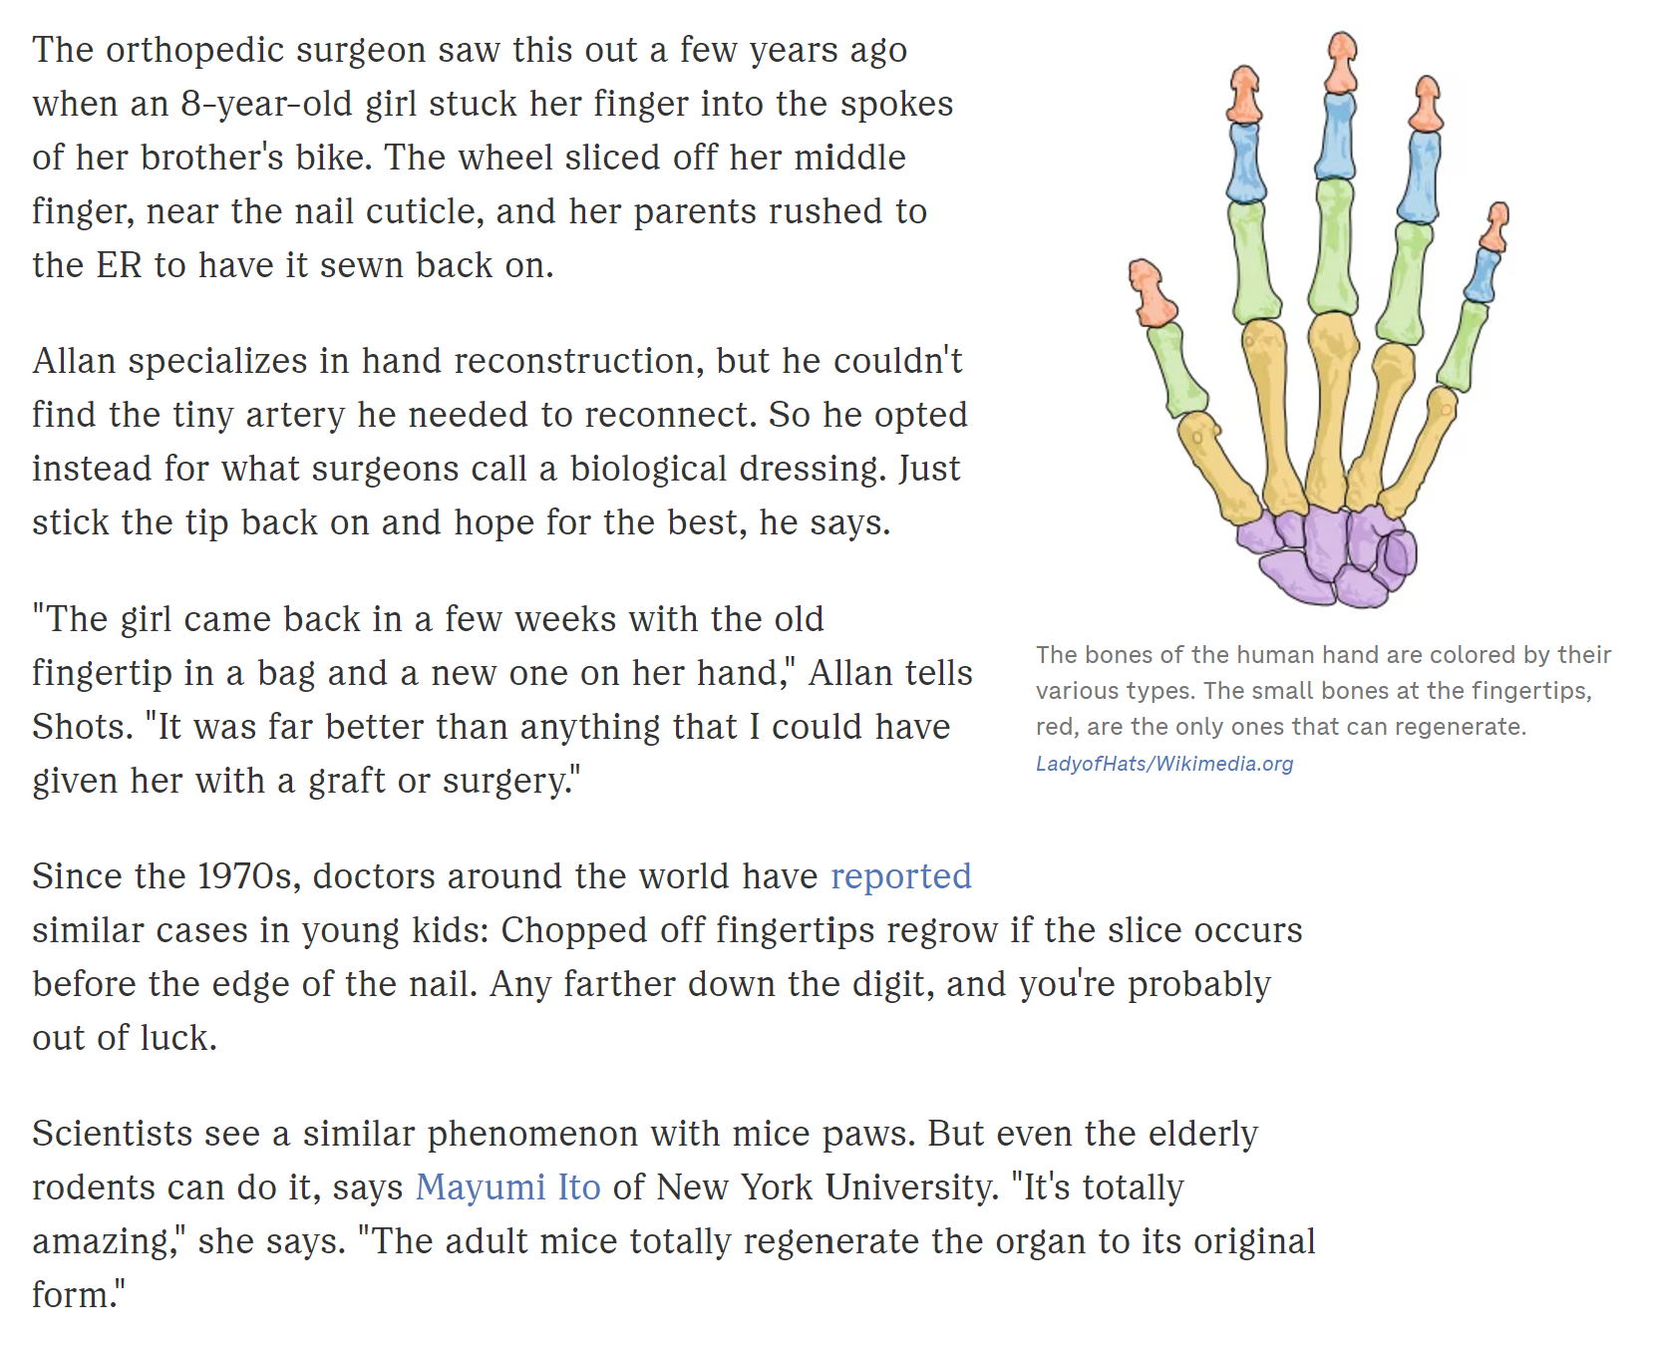
Notes:
Chopped: How Amputated Fingertips Sometimes Grow Back : Shots - Health News : NPR

Slide 6
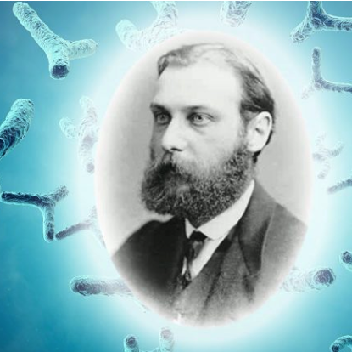
Discovery of Mitosis
Mitosis was first observed by a biologist named Walter Flemming in 1878
He was studying the tissue of salamander gills and fins when he saw cell’s nuclei split in 2 and migrate away from each other to form 2 new cells

Slide 7
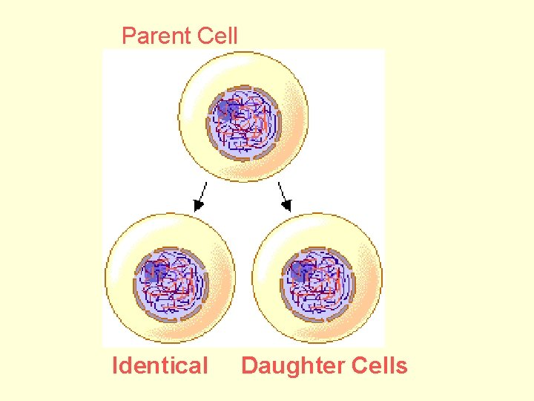
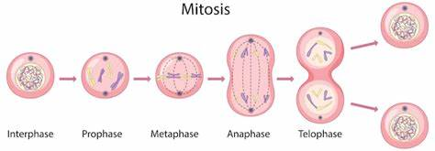
Mitosis
How cells divide, reproduce, and regenerate

Slide 8
Mitosis – PMAT (or IPMAT-C)
I = Interphase (before mitosis)
P = Prophase
M = Metaphase
A = Anaphase
T = Telophase
C = Cytokinesis (after mitosis, cell becomes 2 cells)

Slide 9
Where can we see mitosis happening in humans?

Slide 10
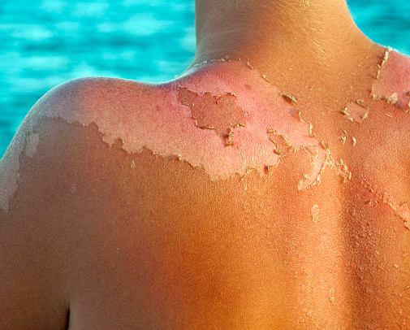
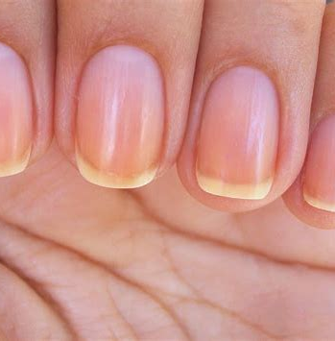
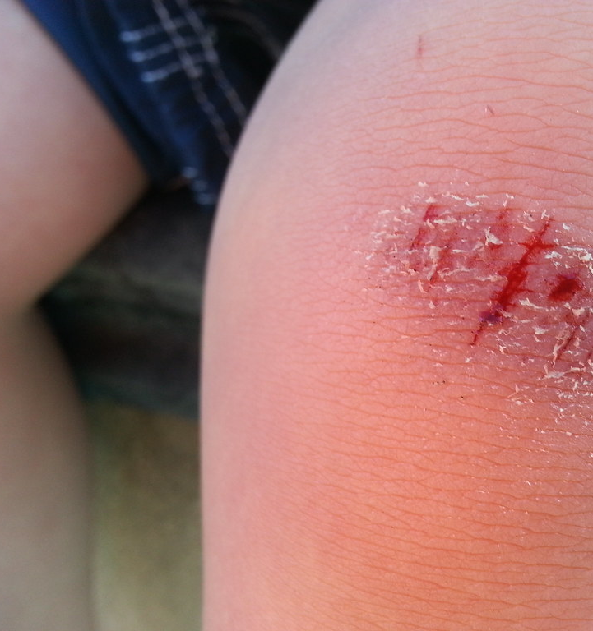
Mitosis in Humans

Slide 11
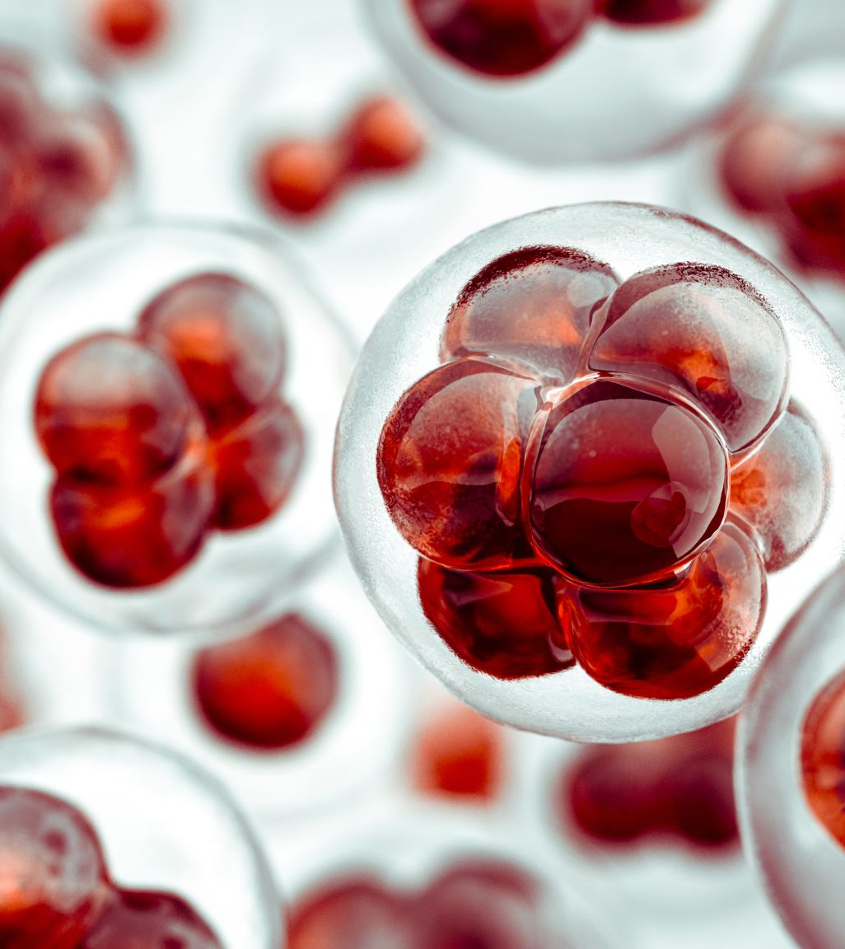
What would happen if our cells did not regenerate properly?
What would happen if our cells regenerate too slow?
What would happen if our cells regenerate too fast?

Slide 12
Kahoot
The Cell Cycle - Details - Kahoot!

